Slide 1
Basho Technologies
RIAKTING TO OPPORTUNITIES

Slide 2
Key Drivers

Slide 3
Availability
Scalability
Durability
Flexibility
Simplicity
Cost

Slide 4


Availability
Notes:
Data availability
Can the system always guarantee read availability, write availability?

Slide 5


Scalability
Notes:
Direction
Vertical scaling hits limits and you just can’t pack anymore inside one machine
Horizontal scaling lets you add more machines to do more work
If you want better service and faster response times, don’t keep bulking up one cop. Bring in a bunch of fresh, fit ones.

Slide 6


Durability
Notes:
Guaranteed to be stored
Per bucket and per request write durability, durable by default.
Fault tolerance
Replication
Failover, replacement

Slide 7


Flexibility
Notes:
Data structure
- Schemaless data.
Overriding defaults
- Per bucket consistency and replication.
- Per request consistency setting.

Slide 8


Simplicity
Notes:
Software stack.
- The software and dependency stack is comparatively simple against tools like Hadoop, Hbase, Cassandra.
Tuning
- It’s often comparatively simple to configure and tune a Riak cluster.
- No necessary dark arts of tuning Linux, and the JVM , and the DB software itself.
Simplicity allows you to invest more in making your application and less in running your application

Slide 9
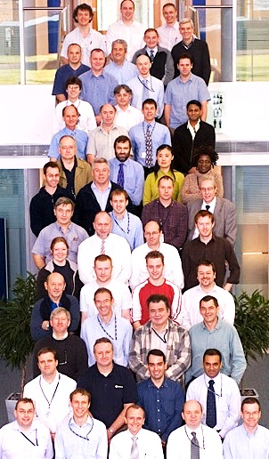
Cost
Notes:
Team size required for management.
Number of machines necessary to make-up the cluster as well as number needed for incremental scaling.

Slide 10

Availability
Scalability
Durability
Flexibility
Simplicity
Cost

Slide 11

Availability
Scalability
Durability
Flexibility
Simplicity
Cost

Slide 12

Availability
Scalability
Durability
Flexibility
Simplicity
Cost

Slide 14



Notes:
Assign these to groups to apply the framework themselves.
Shopify: Online e-commerce as a service platform
Vimeo: User generated video content provider/aggregator
Quantcast: Marketing analytics research and reporting

Slide 15
Availability
Scalability
Durability
Flexibility
Simplicity
Cost

Slide 16
Key Drivers

